Slide 1
Cloud Computing Services
By
Arun

Slide 2
Layout
TLDR
Deep Dive
Hands-on

Slide 3
Disclaimer
Rapid Change is the new normal
arunvela@cdac.in
arunvel.wordpress.com
Arunvel Arunachalam [linkedin]
Mob - 9028825645

Slide 4
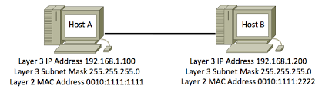

Slide 5
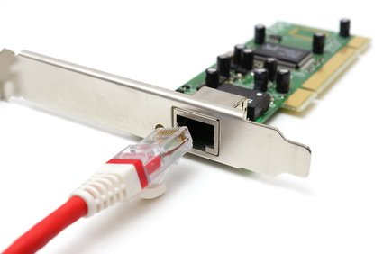

Slide 6
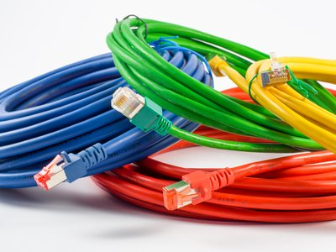

Slide 7
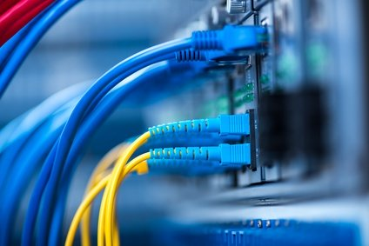

Slide 8
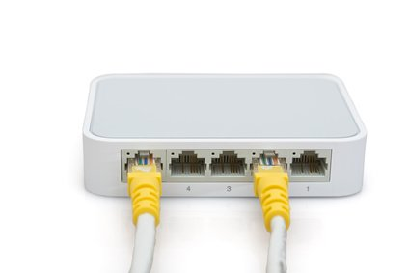

Slide 9
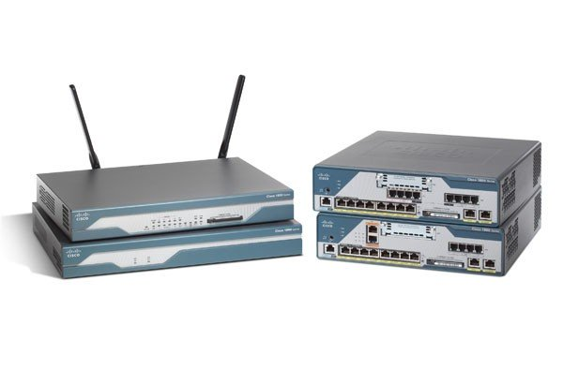

Slide 10
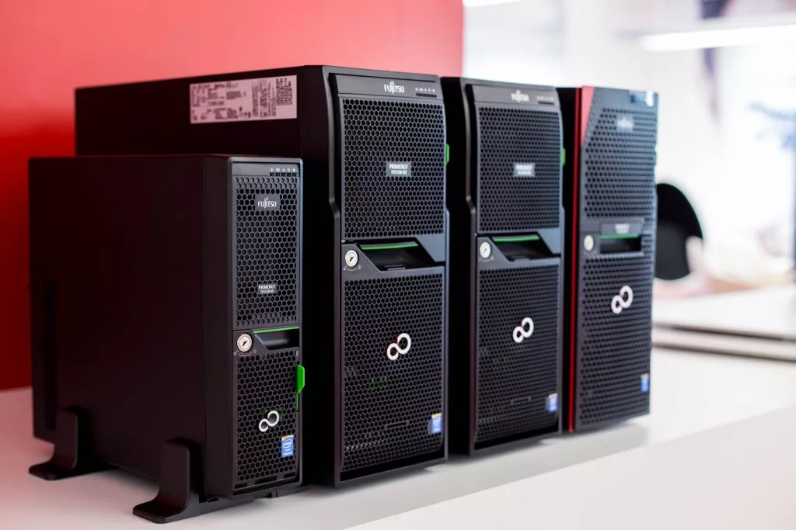

Slide 11
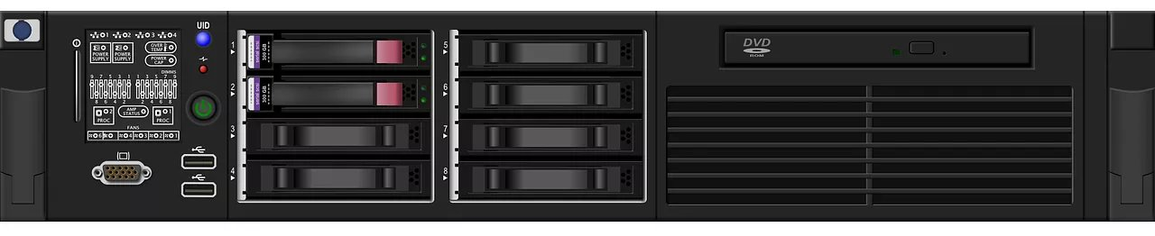

Slide 12
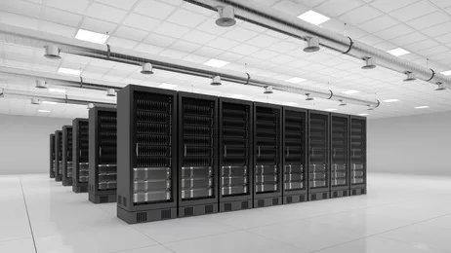

Slide 13
1 RU = 1.75 inch
19 inch = Rack
23 inch = Rack

Slide 14
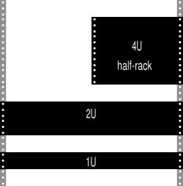

Slide 15
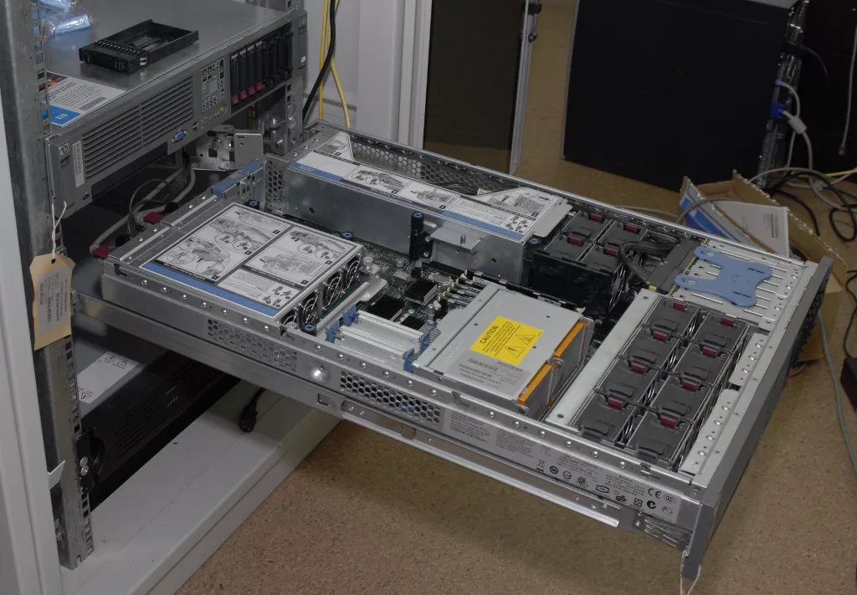

Slide 16
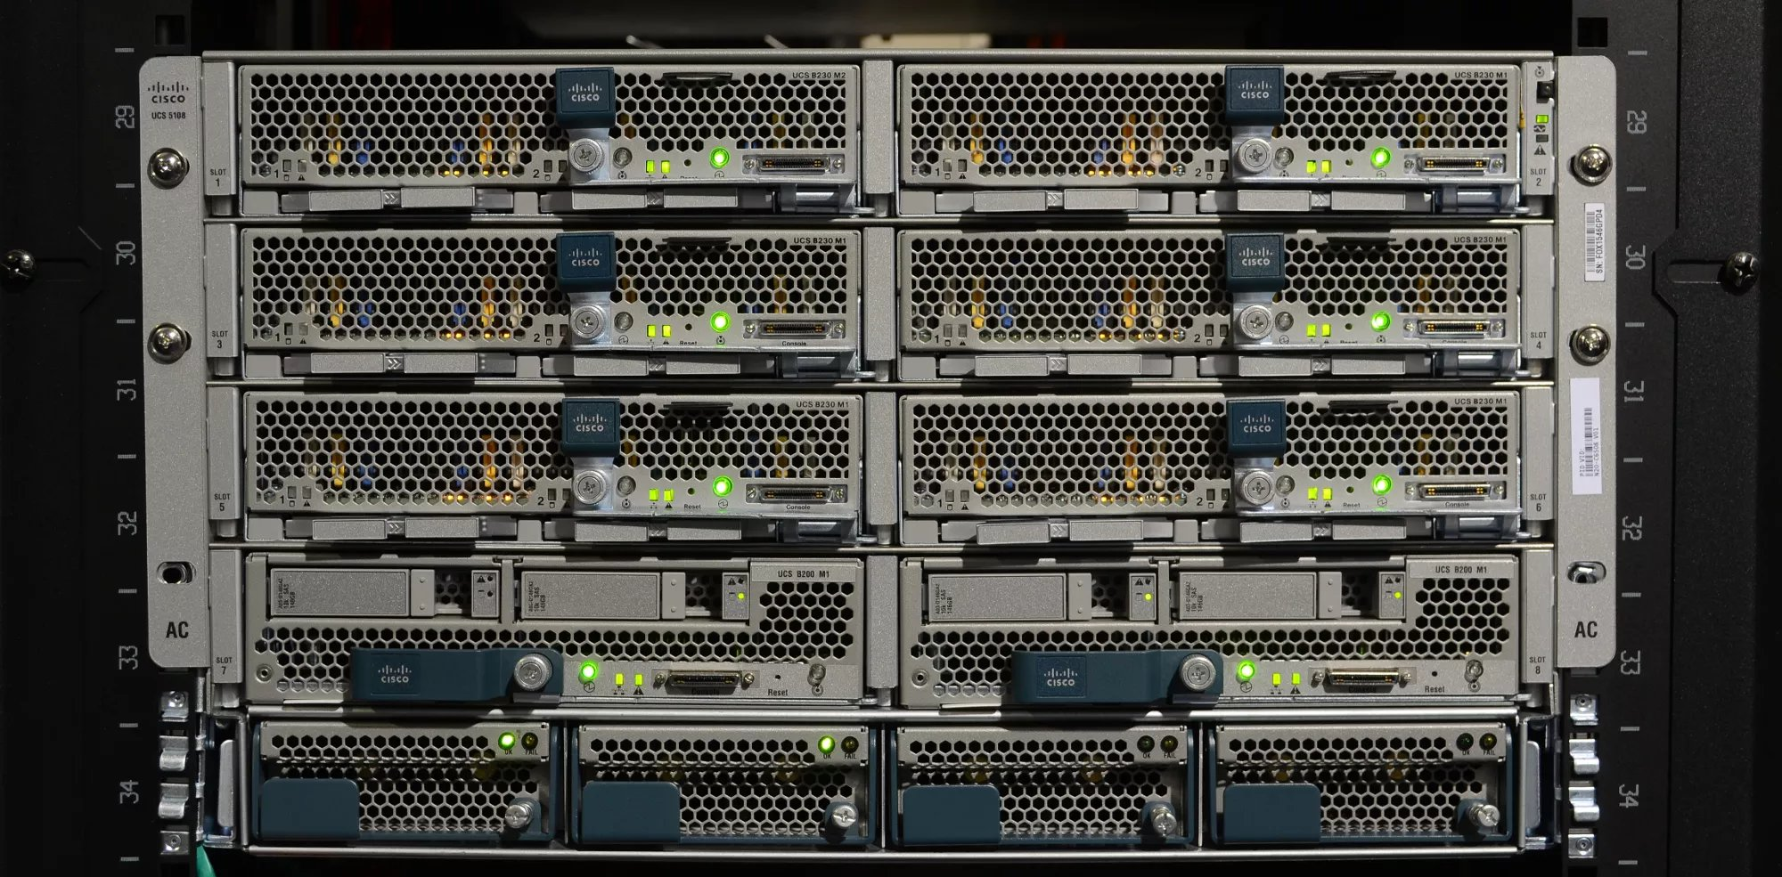

Slide 17
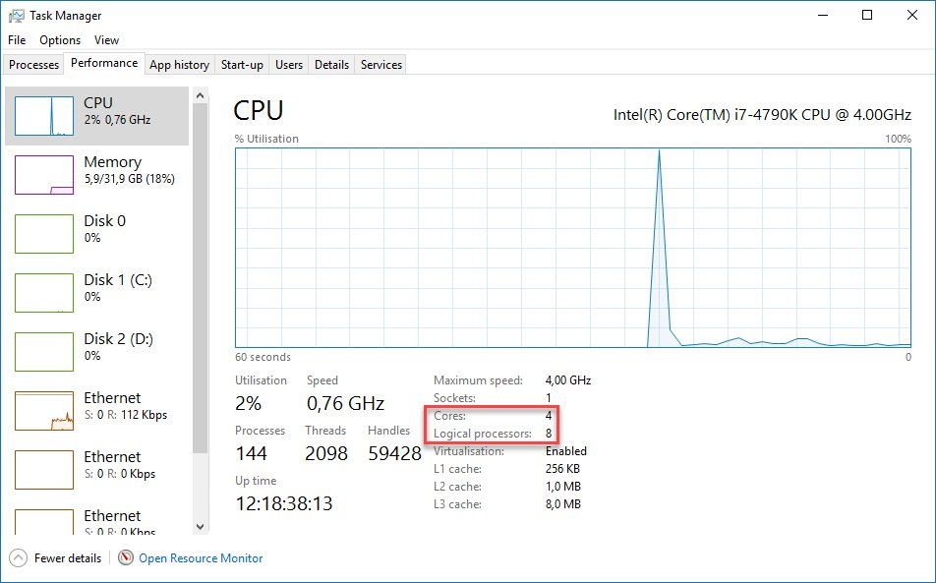

Slide 18
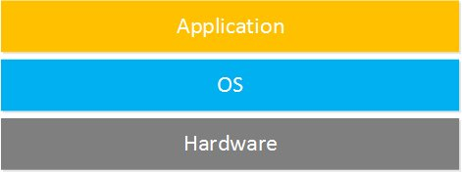

Slide 19
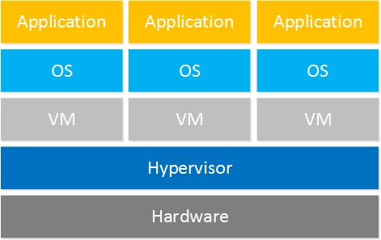

Slide 20
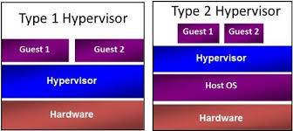

Slide 21
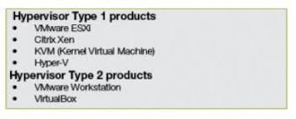

Slide 22
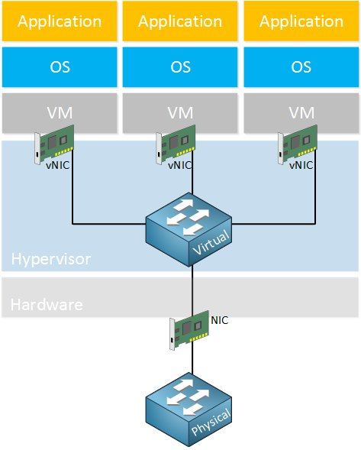

Slide 23
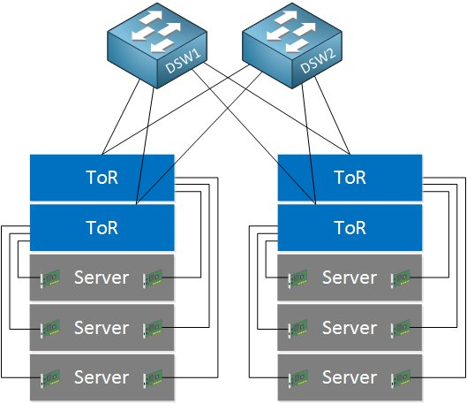

Slide 24
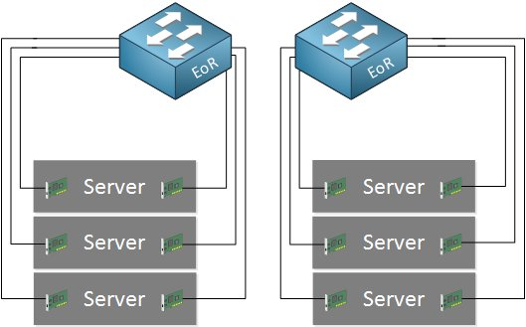

Slide 25
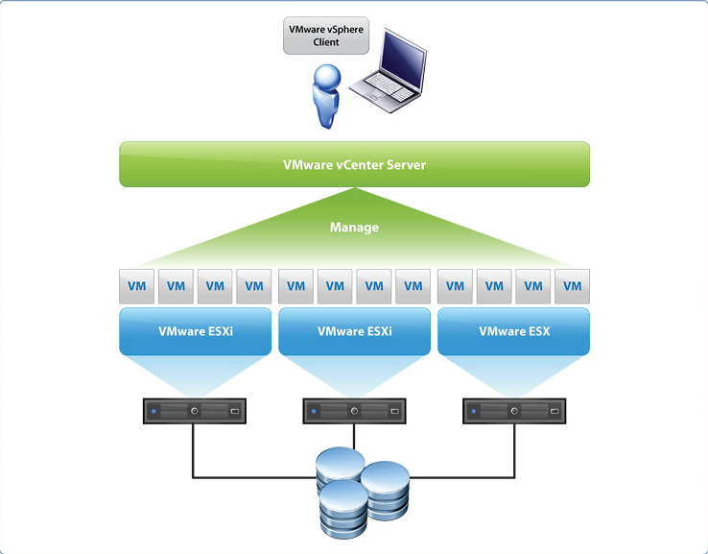

Slide 26
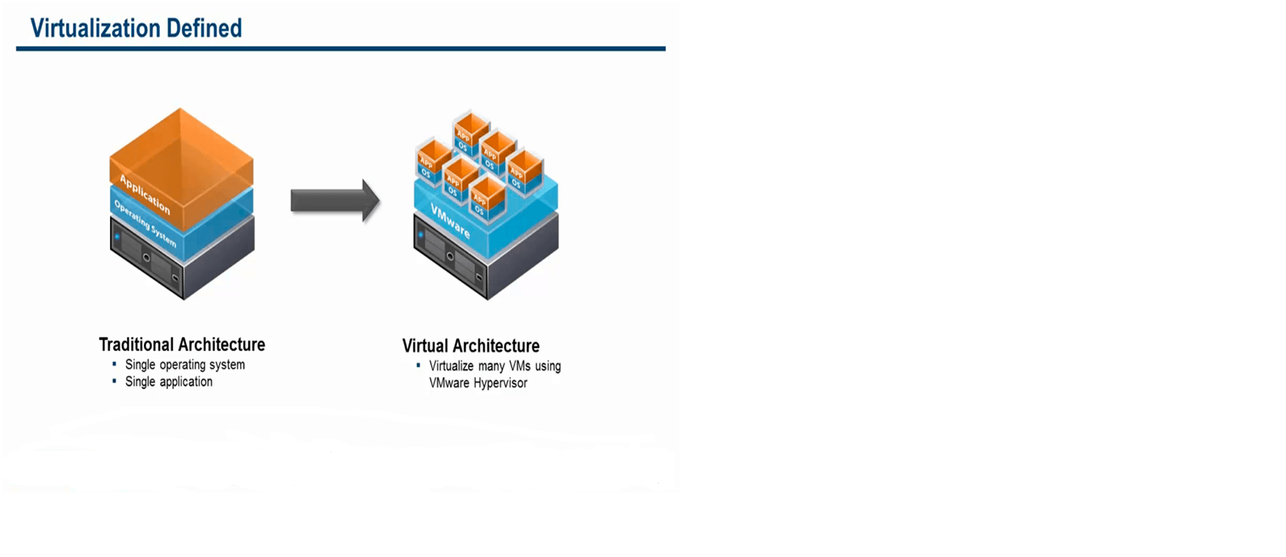

Slide 27
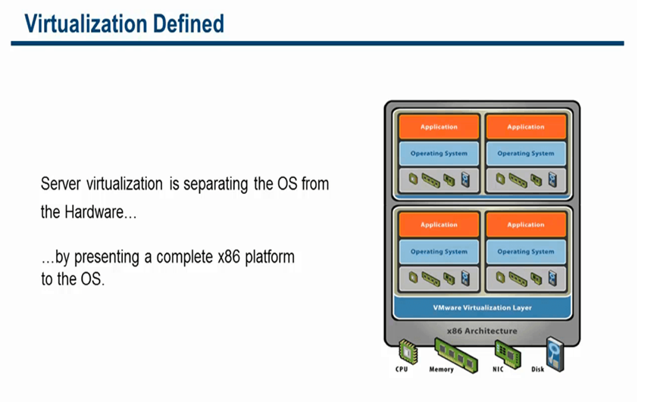

Slide 28
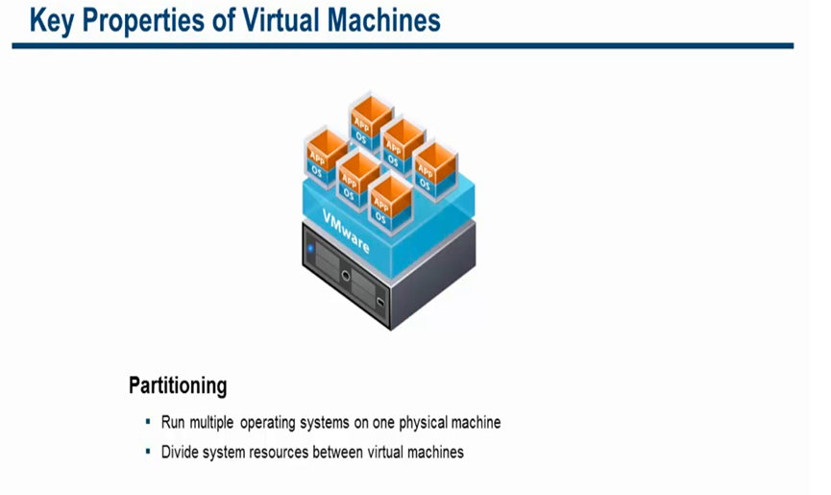

Slide 29
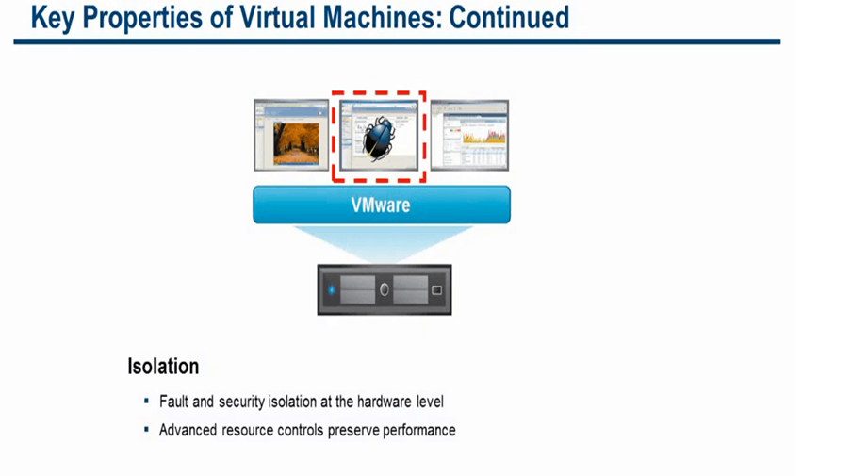

Slide 30
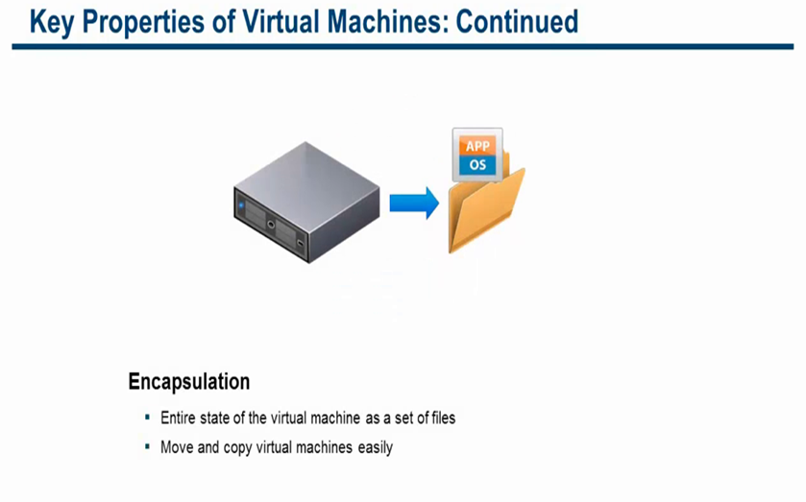

Slide 31
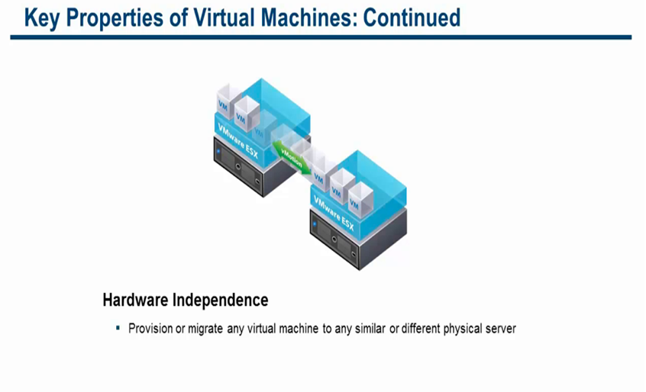

Slide 32
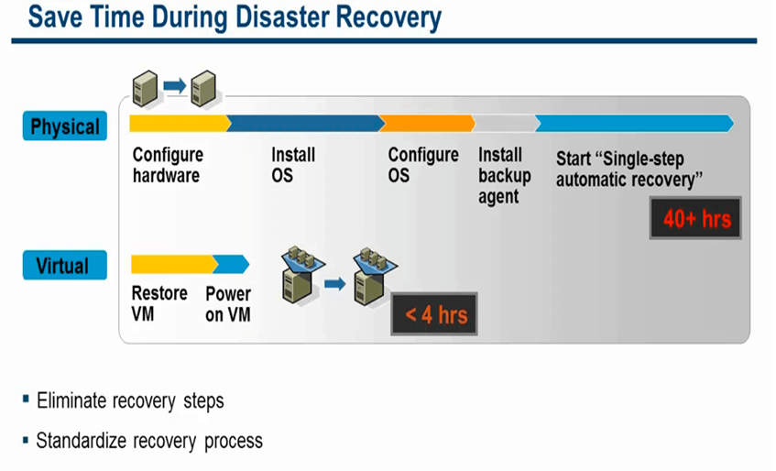

Slide 33
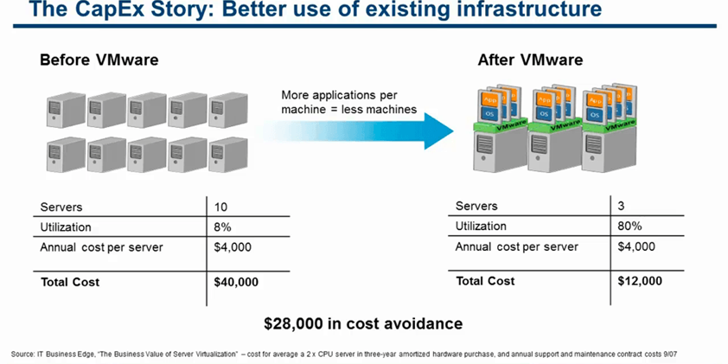

Slide 34
Data Center Components
Basic Data Center facility systems:
Physical space
Raised flooring
In-room electrical
Standby power
Data cabling
Cooling
Fire suppression

Slide 35
Data Center Components
Physical Space
Physical space refers to the footprint that Data Center-related items occupy. This generally applies to the overall area of the Data Center and its associated spaces, such as electrical rooms or storage areas. On a smaller scale this might refer to key dimensions within the Data Center, such as the external measurements of a server cabinet or aisle clearances.
Raised Flooring
Raised flooring is an elevated grid system that is frequently installed in large Data Centers. Cooled air, electrical whips, and data cabling are routed through the space under the raised floor, promoting better air flow and enabling easier management of power and cable runs.
Water pipes, fire suppressant cylinders, moisture detectors, and smoke detectors may be located here as well.

Slide 36
Raised flooring can vary in height from a few inches to several feet, or a few centimeters to several meters. In extreme cases they are as tall as the story of a building, enabling workers to walk upright under the plenum.
Regardless of their height, the floors are typically composed of standard 2 foot (60 centimeter) square floor tiles.
The tiles can vary in weight, strength, and finish depending upon their use.
Tiles featuring either small perforations or large cut-out sections are placed in key locations to enable pass-through of air and cabling between the areas above and below the floor.

Slide 37
In-Room Electrical
In-room electrical refers to all power-related facilities within the Data Center. This normally includes electrical panels, conduits, and several types of receptacles.
Power to this system usually comes from an outside commercial power source, namely your local utility company, and is likely conditioned at the company site. Voltage varies from one country to another.

Slide 38
Cabling
The cabling system is all structured cabling within the Data Center.
Copper and fiber cabling are the typical media and are terminated via several types of connectors.
Common components include fiber housings, patch panels, multimedia boxes
Cooling
The cooling system refers to the chillers and air handlers used to regulate ambient temperature and control humidity within the Data Center.
This system might incorporate the air conditioning system used to cool regular office space within the same building, known as house air, or might be independent of it.
Individual server cabinets can also possess their own cooling measures, such as fans or water-cooling.

Slide 39
Fire Suppression
Fire suppression includes all devices associated with detecting or extinguishing a fire in the Data Center. The most obvious components are water-based sprinklers, gaseous fire suppression systems, and hand-held fire extinguishers. Others can include devices that detect smoke or measure air quality.
Other Infrastructure Components
There are also some infrastructure items that do not strictly fall under the prior categories but are commonly found in server environments. These include leak detection devices, seismic mitigation, and physical security controls such as card readers and security cameras.

Slide 40
Standby Power
Standby power includes all backup power systems responsible for support of the Data Center's electrical load in the event that normal utility power fails for any reason.
This system traditionally includes large batteries, known as an uninterruptible power source or uninterruptible power supply, and one or more generators.

Slide 41
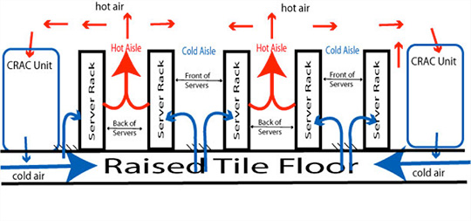
CRAC – Computer Room A/C

Slide 42
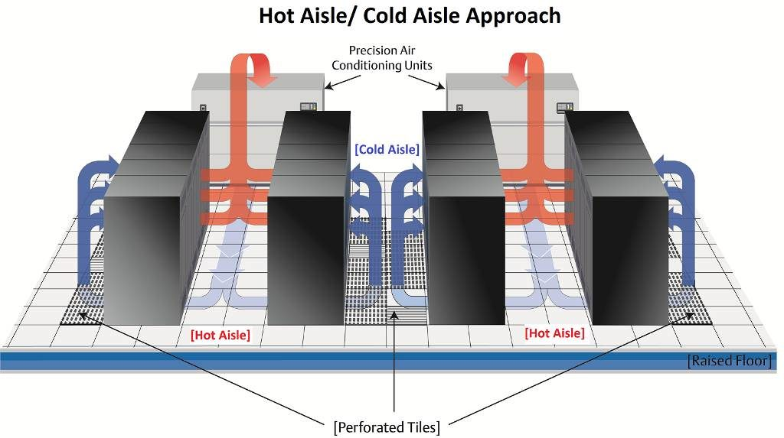

Slide 43
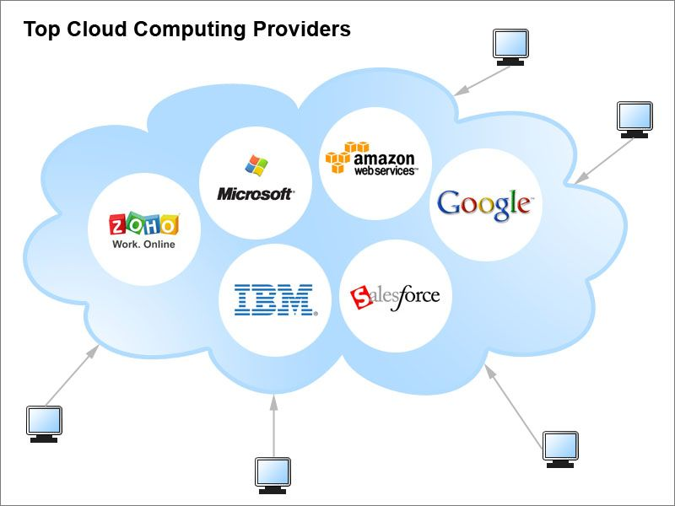

Slide 44
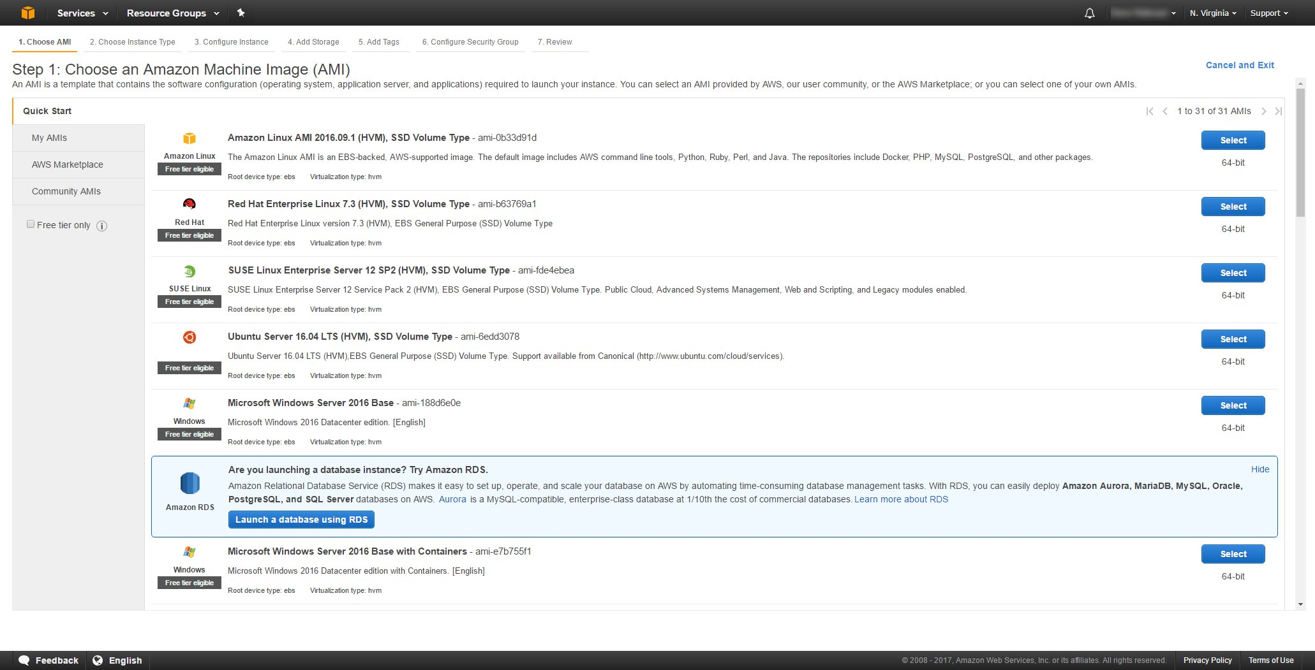

Slide 45
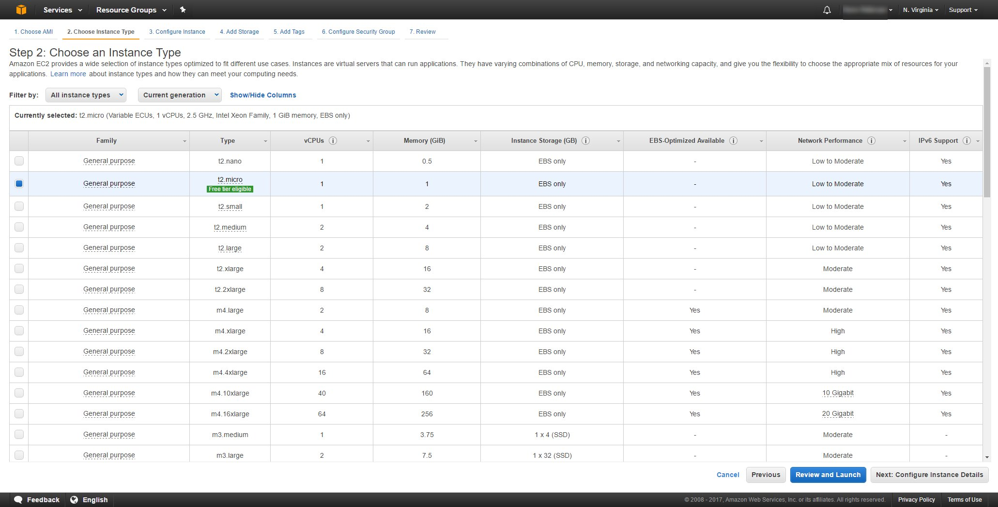

Slide 46
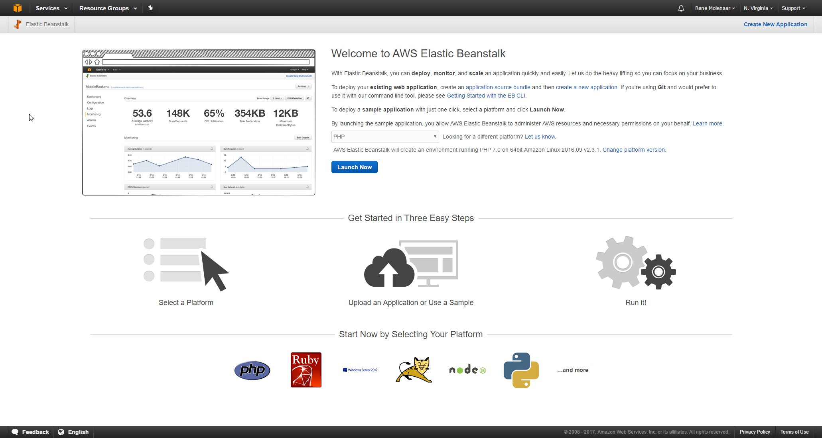

Slide 47
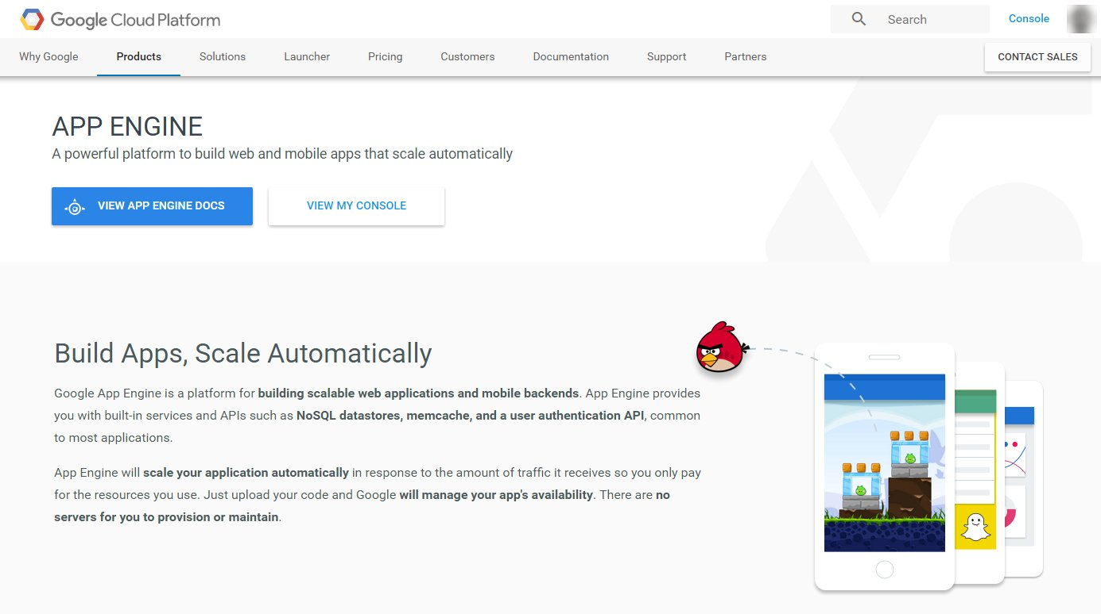

Slide 48
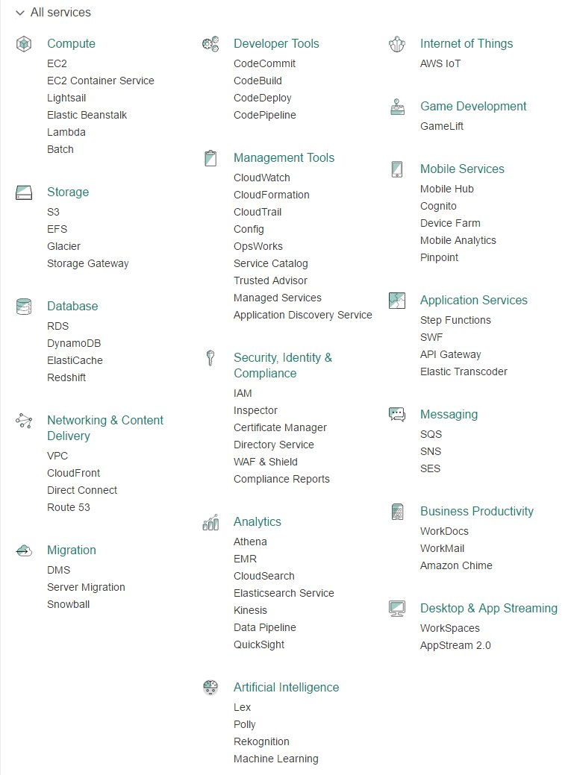

Slide 49
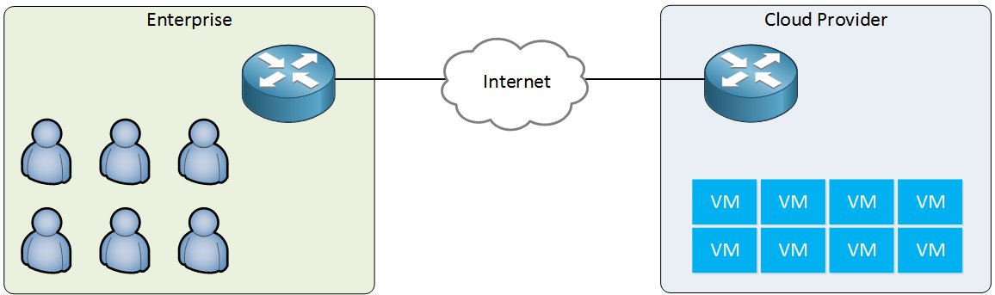

Slide 50


Slide 51
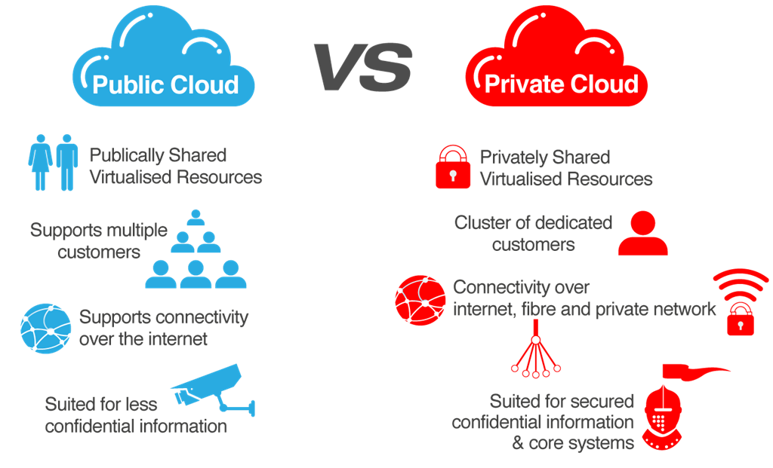

Slide 52
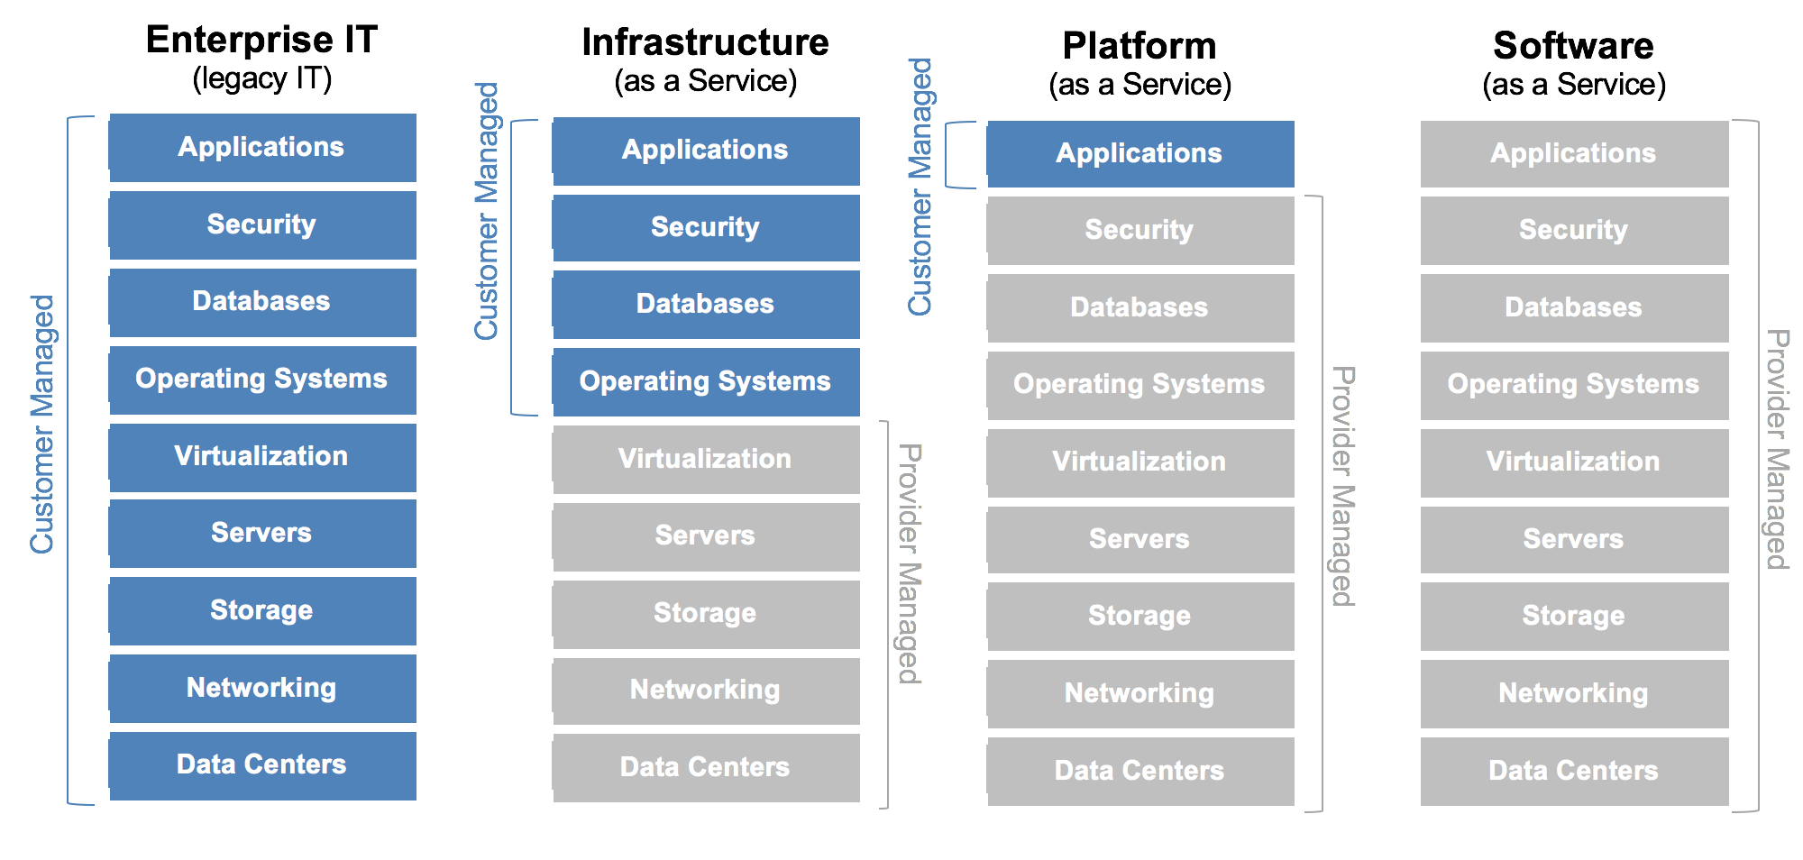

Slide 53
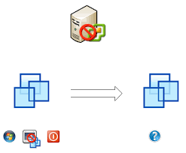
Clone

Slide 54
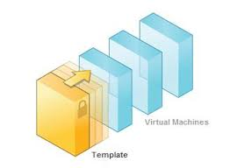
Template

Slide 55
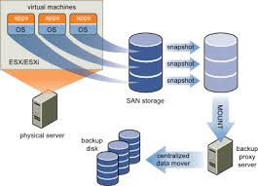
Snapshot

Slide 56
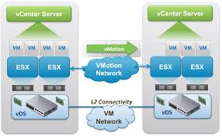
Live Migration

Slide 57
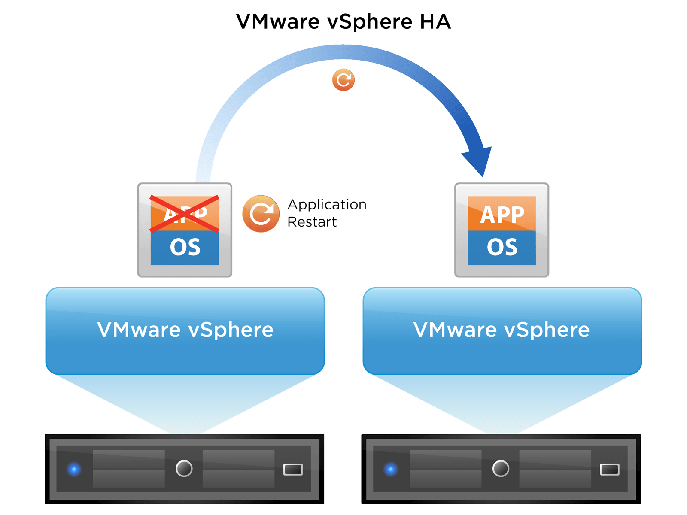
HA

Slide 58
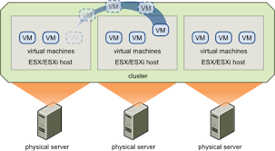
DRS

Slide 59
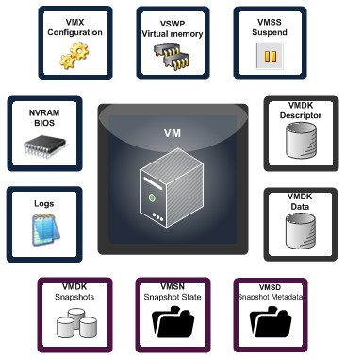

Slide 60
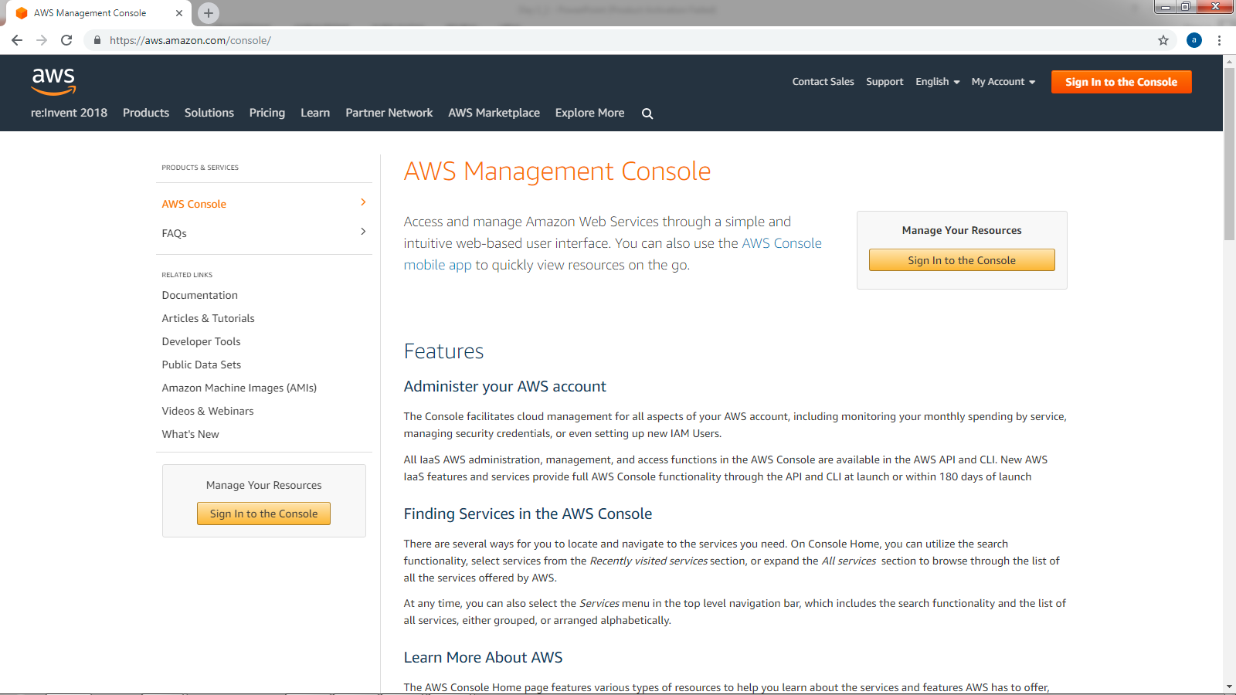

Slide 61
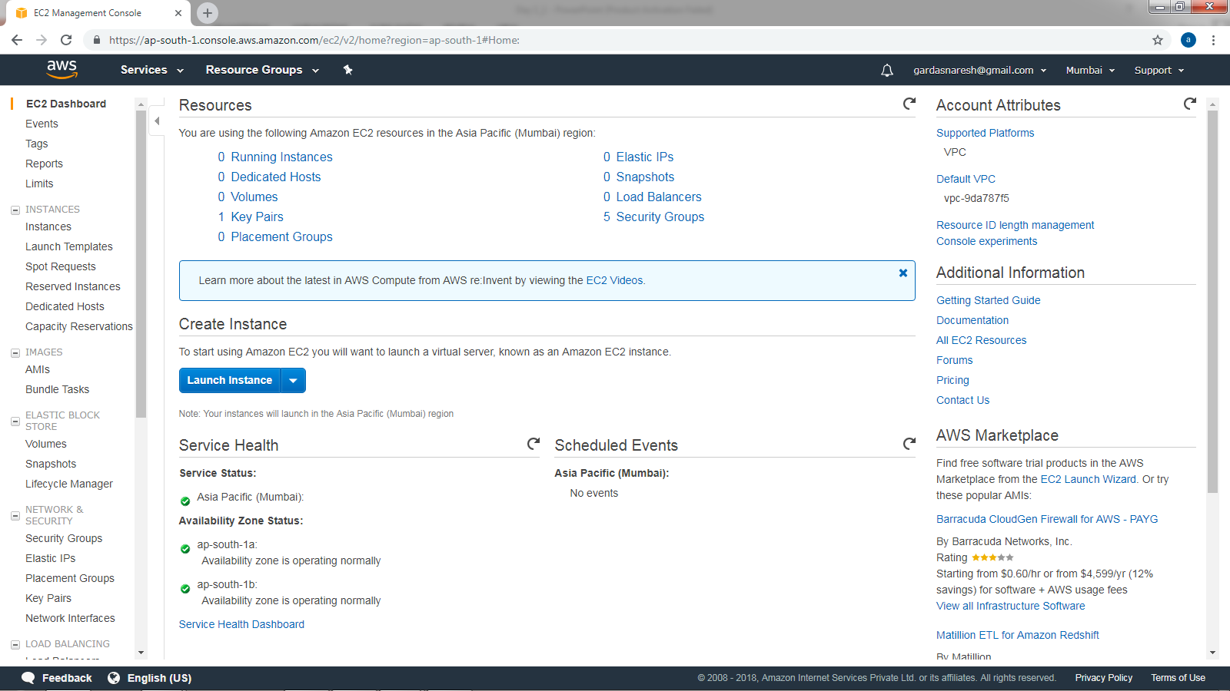

Slide 62
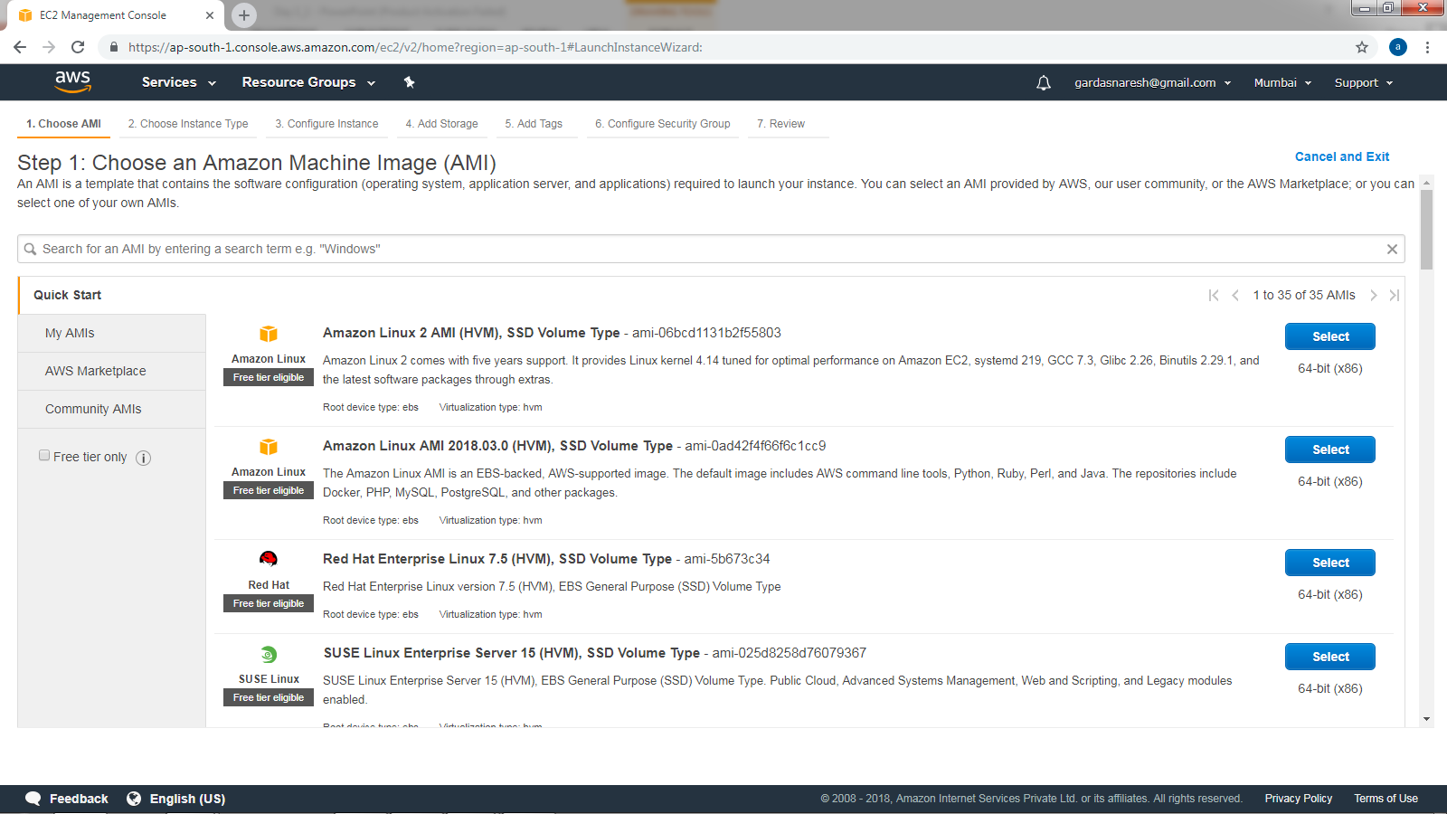

Slide 63


Slide 64


Slide 65


Slide 66


Slide 67


Slide 68


Slide 69


Slide 70


Slide 71


